Slide 1
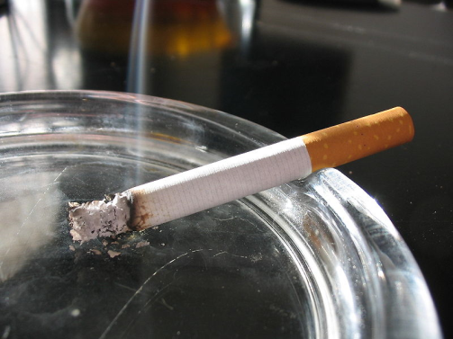


Smoking
Alcohol
Drugs

Slide 2
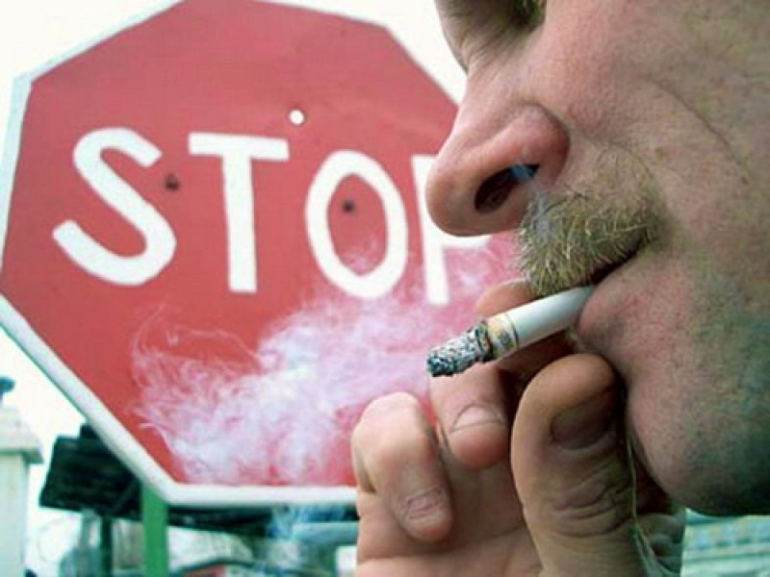
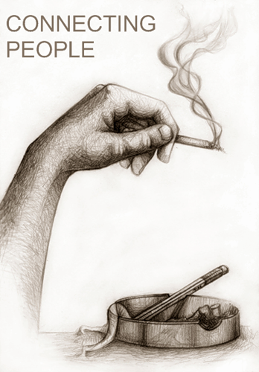
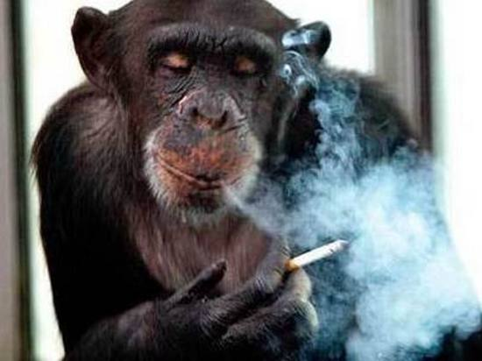
Smoking

Slide 3
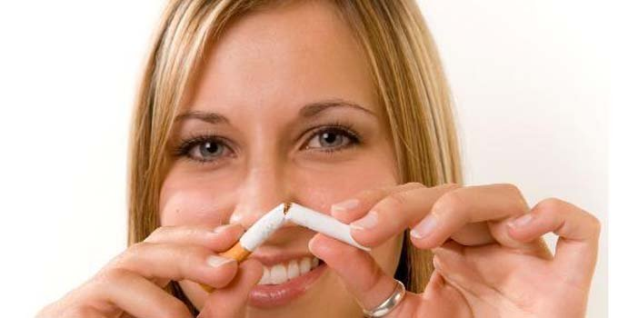
Smoking is bad, because it damages your health.
Even though we all know about the health risks connected to smoking, thousands of people decide to start every year - and a large number of adults who carry on smoking say that they started when they were under 16.
You may be pressured into starting by some of your friends, you may want to copy older relatives who smoke or you may just be curious about what it's like. Whatever sort of pressure you're put under, it's a lot easier to say no than taking up the habit and trying to give up after years of regular smoking.
It also costs a lot of money. If you get through ten cigarettes a day, it costs over £1,200 every year. Think of all the stuff you could buy with that money!
People who smoke regularly are more likely to develop certain illnesses when they get older. These include lung cancer, heart disease and emphysema. It can also reduce fertility.

Slide 4
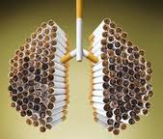
•cigarettes don't make you relaxed; in fact, smoking actually speeds up your heart rate
•you might think that you'll give up when you're a bit older, but the longer you carry on smoking,
the harder it will be to quit
•the only way smoking makes you look older is by giving you wrinkles at an early age
Ways to give up
You can also get chewing gum that releases nicotine
into your body through the lining of your mouth.
You can buy patches and gum from most chemists, or
your doctor may be able to write you a prescription.
Always check with your doctor before you start using
any nicotine replacement products.

Slide 5



Drugs

Slide 6
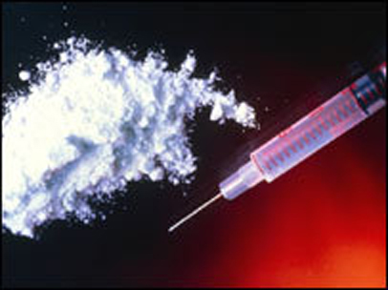
Using drugs now is the most dangerous problem.
Drug users don't start using drugs to become addicted on purpose. But with many drugs containing substances that are addictive, people who use them casually in their spare time can then become regular users.
Reasons why people start using drugs can include:
•to escape problems they may be having in other parts of their life
•peer pressure and fitting in with another group of people
•being curious about the effects of drugs
Becoming dependent on drugs can affect your family and friends. It can also have a serious impact on your own physical and mental well-being.
Drug overdoses can be fatal, and you can die instantly from misusing drugs that you can buy over the counter. This includes things like aerosols, glues and other solvents.
Anxiety and changing sleeping habits can also be signs of drug use. However, these symptoms can also be caused by changes in your body, stress or other problems.
Drugs are categorised into three classes based on their overall level of harm. Class A drugs are the most dangerous and Class C drugs are less dangerous. However, all the drugs in all three classes are harmful and are addictive.
Remember that all categorised drugs are illegal, even Class C drugs like GHB and ketamine. If you're caught selling them onto other people, or carrying a small amount in your pocket, it's likely that the police will get involved. If you're found guilty of any of these offences, you may face a fine or time in custody. Class A drugs carry the most severe sentences.

Slide 7
